Slide 1

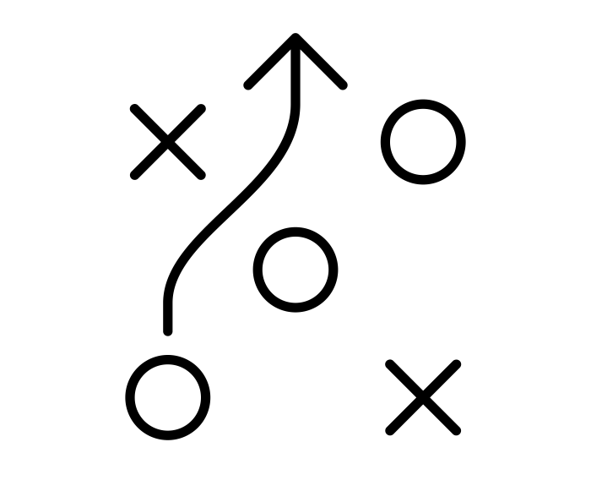
South Hadley Municipal Affordable Housing Trust Action plan kickoff 29 January 2025
Presentation by
Jenn Goldson, AICP
Noah Harper, AICP
JM Goldson LLC

Slide 2
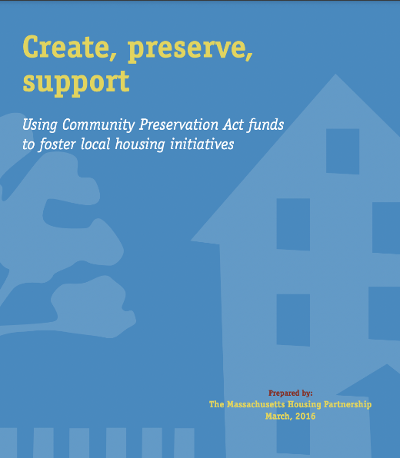
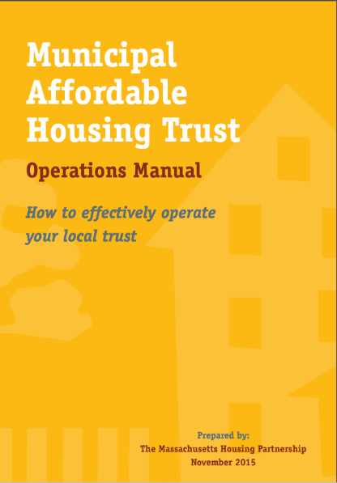
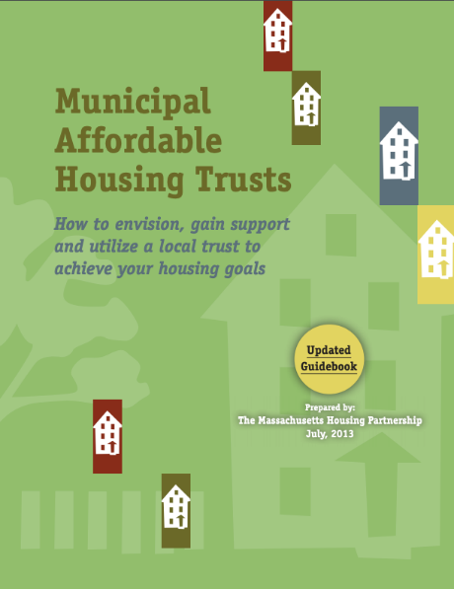
Introductions
Jenn Goldson, AICP, Founder & Managing Director
Noah Harper, AICP, Community Planner for Housing & Equity
JM Goldson LLC, since 2006
Among our specialties:
Housing plans and housing trusts
Comprehensive master plans
Community engagement
Community preservation plans
Zoning for housing production
Municipal disposition of land for housing
Honored as principal author of 3 MHP Guidebooks

Slide 3
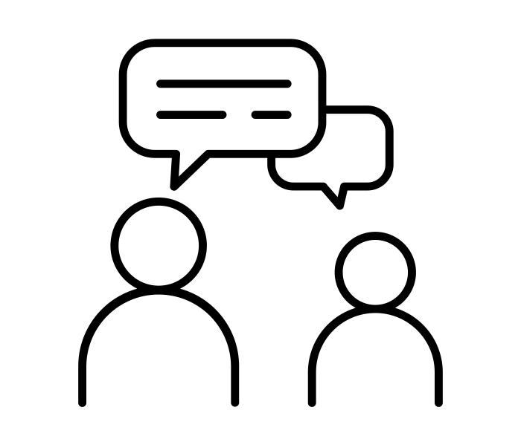
Introductions
Tell us:
Your name and any relevant affiliation
How long you’ve lived in here
What draws you to work on local housing issues? What’s your why?

Slide 4

Presentation Topics
Trust Training 101
Overview of a Strategic Plan
Your Hopes & Expectations
Schedule & Next Steps

Slide 5
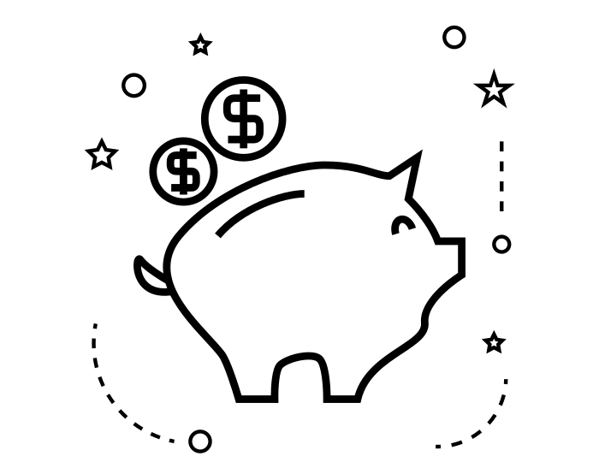
Trust Training 101
Municipal Affordable Housing Trusts
Notes:
A place to put funds dedicated for affordable housing.

Slide 6
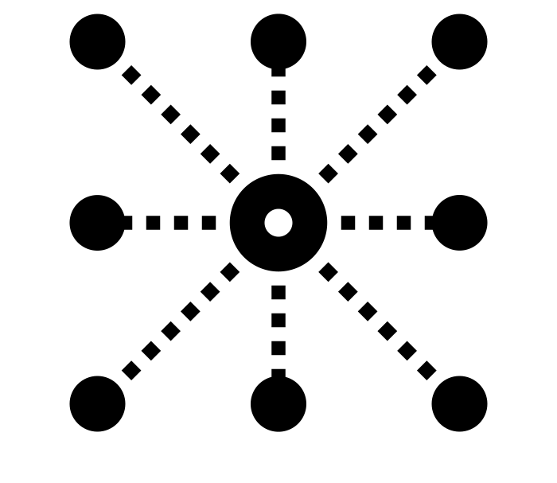
Purpose of a housing trust
To create and preserve affordable housing

Slide 7

What does the board of trustees do?
Oversee the funds
Act like bankers but can also initiate ideas
Partial List of Powers:
Buy, sell, rent
Borrow against future trust revenue
Do not need Town Meeting or Select Board approval

Slide 8
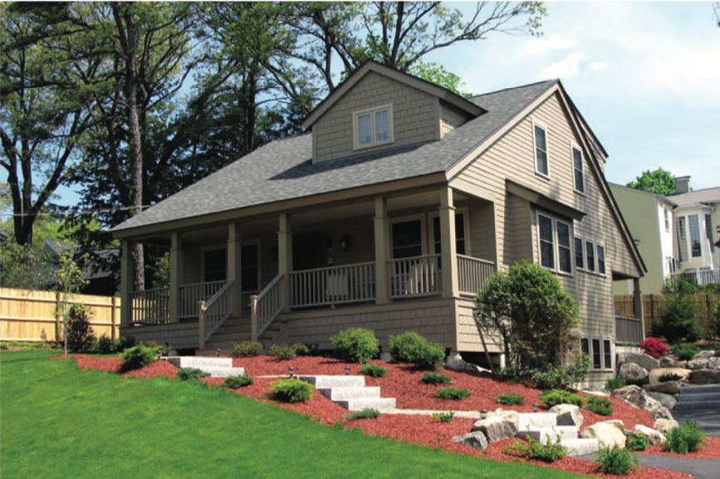

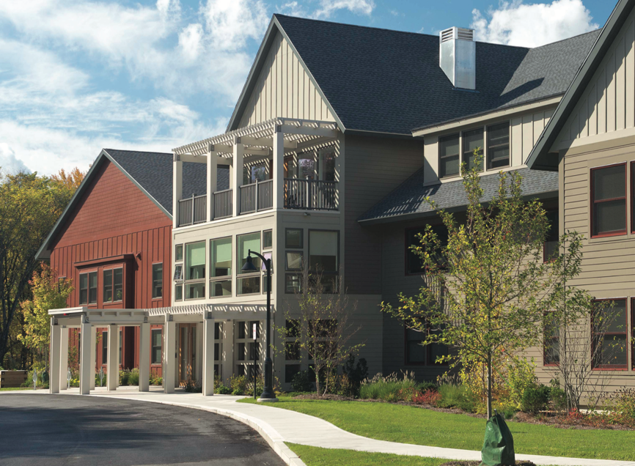
What can you do with trust funds?
Create
New construction
Andover: Cheever Road
Homeownership Development
Sudbury: Habitat for Humanity Duplex
Homeownership Development
Carlisle: Benfield Farms
Senior Rental Development
Source: MHP’s Municipal Affordable Housing Trust Guidebook, v.3

Slide 9
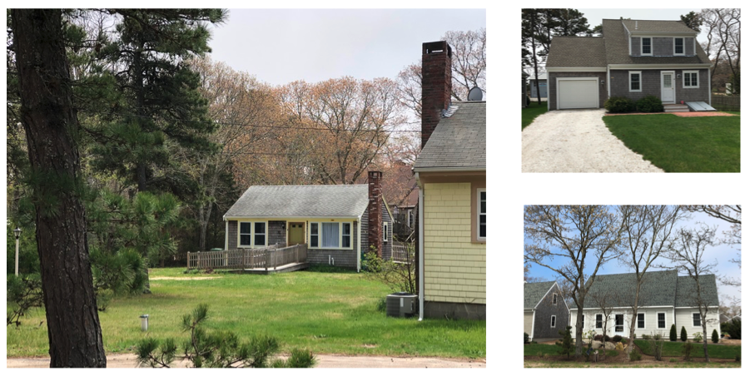
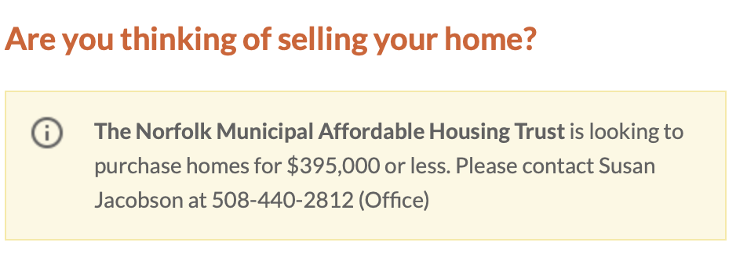
What can you do with trust funds?
Create
Reuse
Norfolk: Buy Down Program
Convert Market Rate Units to Affordable Homeownership
Eastham: Rental Unit Program Convert Market Rate Units to Affordable Rental

Slide 10
What can you do with trust funds?
Preserve
Expiring affordability restrictions
Amherst: Preserve Affordable Units
Because mortgage was repaid affordable restrictions would have expired, so the town supported a new owner to buy the property and establish new affordable restrictions.

Slide 11
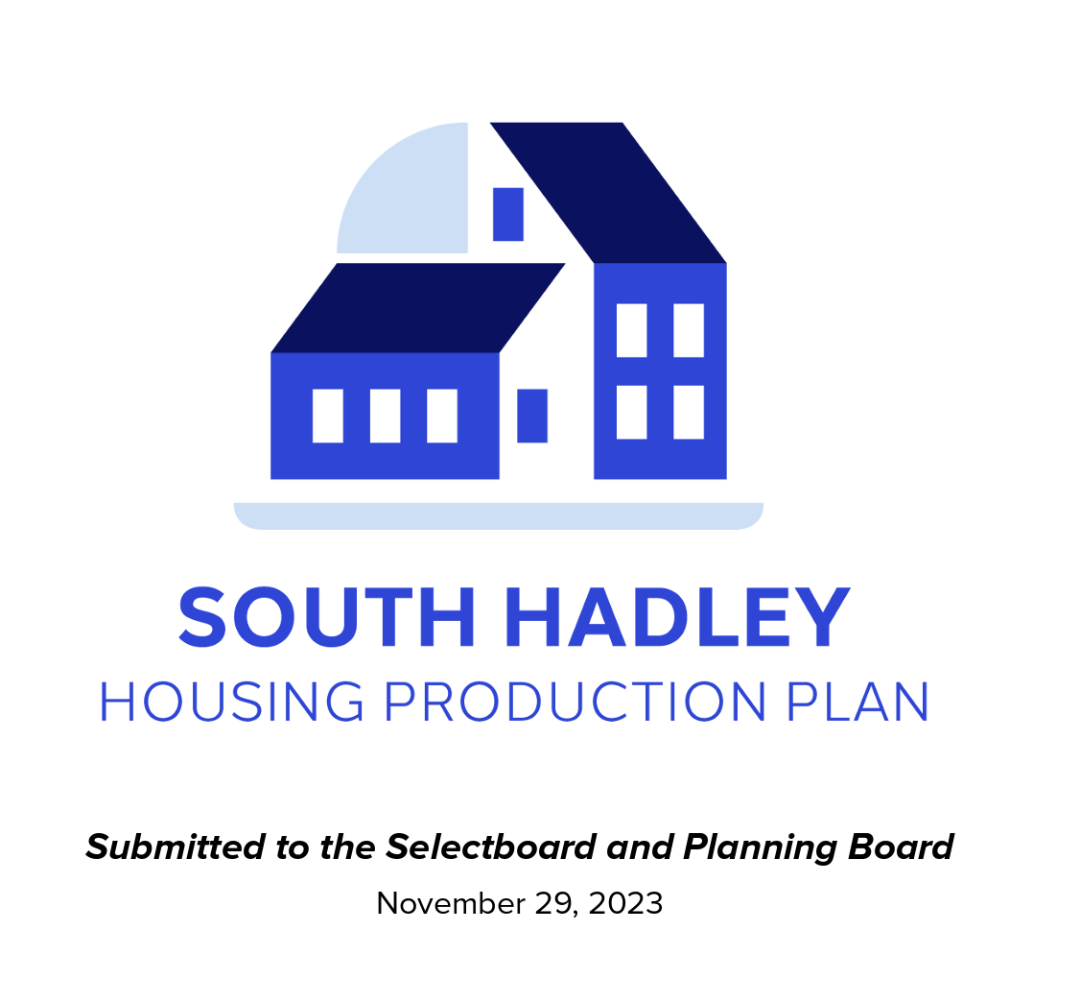
S. Hadley Housing Production Plan
Strategy 3: Land Purchase for Housing "Facilitate small-scale deed-restricted Affordable Housing production by purchasing land or buildings that can be used for housing." This includes:
Acquiring land through surplus properties, tax foreclosures, or real estate listings.
Donating or selling land to nonprofits for Affordable Housing development​​.

Slide 12
Where can the trust get revenue from?
Inclusionary zoning payments
Negotiated developer fees
Cell tower leases
General fund
Tax title sales
Municipal bond
Tax override
CPA
Notes:
CPA considered in 2015-2016 but not adopted.

Slide 13
3 frameworks: trust board’s approach
Initiator – initiates projects and facilitates implementation directly
Funder – takes applications and determines which to fund
Hybrid – some combination of both above
*Some Trusts also take on an advocacy role (similar to a Housing Partnership)

Slide 14
Overview of a Strategic Plan

Slide 15

purpose
TAKE A STEP BACK SO YOU CAN MOVE FORWARD
What would make you most proud? What are you aiming for?
What priorities should you focus on that will help you achieve your mission?
How should you operate to be most effective?
By answering these questions, you can create a strategic plan to focus the trust’s efforts over the next 5 years
Notes:
MGL c.44B

Slide 16

What is included in a strategic plan?
Mission – states your reason for existence
Strengths, weaknesses, opportunities, issues – a rundown of your current situation
Strategies & actions – what will you spend your energy, time, and funds on in the next 5 years?
Capacity – what gaps need to be filled so that you can effectively implement your plan?

Slide 17
Important Note
This Plan is funded by a MVP 2.0 Grant (Municipal Vulnerability Preparedness)
A state program to improve climate resiliency at the municipal level
The greatest threat in S. Hadley that creates the greatest vulnerability for people was identified as housing affordability
One of the criteria for funding projects out of the Trust is that they must in some way improve climate resilience/address climate change

Slide 18
Your hopes

Slide 19

Your hopes?
Effectively establish and capitalize the Affordable Housing Trust
Explore options to create affordable housing
Create greater density in developed areas and preserve open space
AHTF as a catalyst for policy changes to create affordable housing
Educate citizens on affordable housing and engage the community
Create alternative affordable housing through private development

Slide 20

most curious to learn?
How the Trust can partner with entities like Habitat For Humanity
More about affordable housing in Massachusetts
Opportunities for creating affordable housing without public subsidy (or a hybrid approach)
Specific actions the Trust can take to spur affordable housing development

Slide 21

GREATEST CHALLENGES?
Resistance to change and typical objections/concerns (traffic, infrastructure, aesthetics)
Restrictive zoning
Environmental concerns
Access

Slide 22

GREATEST OPPORTUNITIES?
Affordable housing can help people be able to live (or stay) in Town
Exciting momentum at the state and local level
Opportunity to increase housing production for low-income and workforce households
South Hadley’s location and proximity to regional job centers makes it an ideal location for all types of housing

Slide 23
Schedule & Next steps

Slide 24
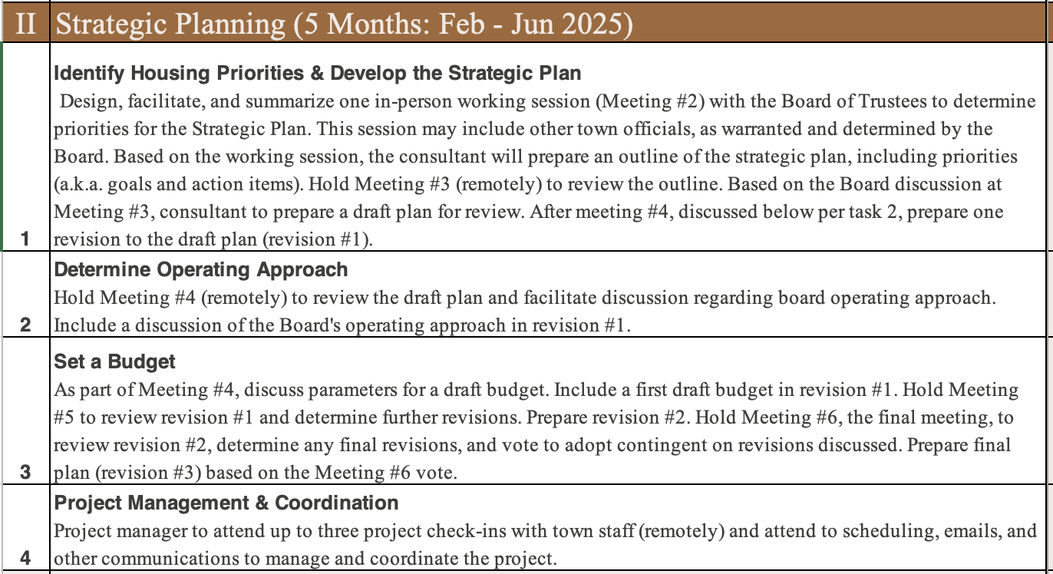
Project scope

Slide 25
Meeting schedule
Meeting #1 Remote – kickoff meeting | Today
Meeting #2 In-Person Working Session | 2/27
Meeting #3 Remote – Review outline of plan | 3/13
Meeting #4 Remote – Review draft plan | 4/3
Meeting #5 Remote – Review revised plan & draft budget | 5/1
Meeting #6 Remote – final meeting to approve the plan | 6/5

Slide 26

2/27 Working Session
Facilitated with discussion activities
Invite other town officials?
Format – small group discussions
6:00-9:00 (3 hours with dinner provided)

Slide 27

Thank you!
Jenn Goldson, AICP
Jennifer@jmgoldson.com
Noah Harper, AICP
Noah@jmgoldson.com
JM Goldson LLC

