Slide 1

School Department
Budget Task Force Presentation
December 1, 2025

Slide 2
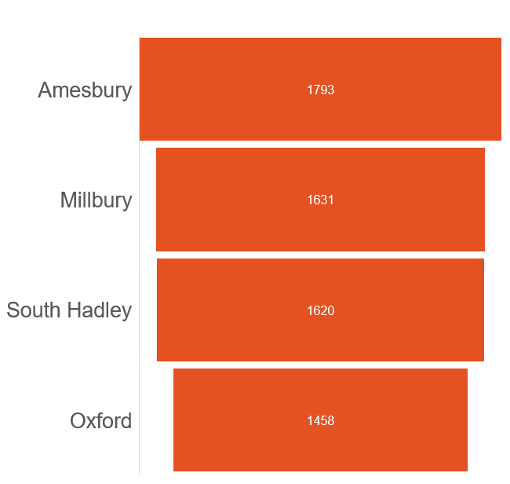
2025 Enrollment

Slide 3
Enrollment Percentage by Special Populations

Slide 4
Total Expenditures per Pupil
 | Amesbury | Millbury | Oxford | South Hadley
2023 | $22,944 | $20,033 | $18,868 | $19,100
2022 | $21,622 | $19,191 | $18,334 | $17,265
2021 | $19,884 | $18,938 | $16,137 | $16,034
2020 | $17,828 | $17,012 | $14,784 | $15,080
2019 | $17,844 | $16,983 | $14,515 | $14,979

Slide 5

Class Size
26 - 28 students
AMESBURY | MILLBURY | OXFORD
16 | 18 | 18
27 students
26 students
20 students

Slide 6
Teacher Salaries
 | Amesbury | Millbury | Oxford | South Hadley
2021 | $86,626 | $81,528 | $74,441 | $75,637
2020 | $81,751 | $83,615 | $70,478 | $71,655
2019 | $79,129 | $78,593 | $69,980 | $72,690
2018 | $76,770 | $78,928 | $69,536 | $70,181
2017 | $76,997 | $81,124 | $68,432 | $74,979
FTE Count (2021) | 159.3 | 134.4 | 116.3 | 142

Slide 7

MCAS test results
2025 Enrollment |  |  |  |  | 2025 MCAS
 |  |  |  |  | % Meeting or Exceeding Expectations |  |  |  |  | Growth Average SGP
 |  |  |  |  | Grades 3 - 8 |  | Grade 10 |  | Gr 5 & 8 | Grades 3 - 8 |  | Grade 10
 | Total Enrollment # | Low Income % | SWD % | ELL % | ELA | Math | ELA | Math | Science | ELA | Math | ELA | Math
Amesbury | 1793 | 33.9 | 25.4 | 4.9 | 39% | 32% | 51% | 43% | 38% | 49 | 42 | 53 | 39
Millbury | 1631 | 33.5 | 21.7 | 5.5 | 38% | 39% | 38% | 38% | 39% | 44 | 47 | 47 | 50
Oxford | 1458 | 42.4 | 24.9 | 5.0 | 33% | 27% | 33% | 20% | 32% | 47 | 39 | 41 | 44
South Hadley | 1620 | 34.9 | 24.6 | 5.1 | 35% | 31% | 49% | 51% | 41% | 53 | 44 | 50 | 64

Slide 8

Staffing

Slide 9
Role | Amesbury | Millbury | Oxford | South Hadley
Administrators | 12.0 | 16.8 | 13.0 | 14.0
Teachers | 169.4 | 129.9 | 125.34 | 141.93
Support Staff | 145.85 | 106.84 | 90.95 | 131.85

Slide 10
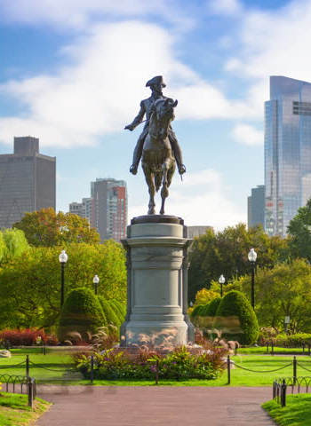
State Advocacy
2024-2025
  High School Student leaders met with State Senator Oliveira and State Representative Homar Gomez to advocate for increased school funding and presented letters of support to review the Chapter 70 funding formula
  District leadership, teachers and students attended the Senate Ways and Means Budget Hearing in April of 2025 and several testified
2025-2026
  State holding Chapter 70 listening session
  Mass Assoc of Superintendents (MASS), Mass Assoc of Business Officials (MASBO), and several other associations sent statements of support to review and fix the funding formula

Slide 11

Measures of Success
College and Career Readiness

Slide 12
Graduation Rates
 | 2024 | 2023 | 2022 | 2021 | 2020
Amesbury | 88.8% | 88.3% | 89.7% | 90.1% | 87.9%
Millbury | 91.9% | 90.4% | 88.3% | 89.0% | 93.9%
Oxford | 86.1% | 80.9% | 86.5% | 86.1% | 82.1%
South Hadley | 92.6% | 93.9% | 96.5% | 96.6% | 95.9%

Slide 13




Graduation Rates and Diploma Pathways
4 Year Graduation Rate is 94%
Adjusted Graduation Rate is 96%
  Reflects students who graduate beyond four years or after returning from a previous cohort
  Students who remain enrolled until age 22 and do not take a diploma are not counted as graduates
Differentiated Diploma Pathways
  State Minimum Requirements: 126 Credits
  South Hadley High School Diploma: Majority of students earn 152+ credits
    The higher credit diploma exceeds state requirements and meets/exceeds minimum expectations for admission to four-year colleges
    Our expanded credit expectations ensure students are college and career ready, demonstrating the rigor and strength of our SHHS program

Slide 14
College Collaborations
AIC collaboration for credits was costing the district money
New collaborations that don’t cost money
Dual Enrollment options with Holyoke Community College (HCC) and Elms College
New UMASS partnership that is available to high school students

Slide 15
Advanced Placement (AP) Classes
20 AP Courses are offered at South Hadley High School
College Credit
Credit is awarded to all students whose class does not pertain to their major in college and have scored a 3 or better on the test
Last year 216 exam were taken and 190 of those exams scored a 3 or higher granting college credit

Slide 16

Budget Drivers

Slide 17
South Hadley Budget Drivers (FY24-FY26)
EMPLOYEE CONTRACTUAL INCREASES
TRANSPORTATION: REGULAR AND SPECIAL ED
SPECIAL EDUCATION
UTILITIES
HEALTH INSURANCE
CONTRACTED SERVICES
OUT OF DISTRICT PLACEMENTS: SPECIAL ED

Slide 18
Amesbury Budget Drivers (FY24-FY26)
Employee contractual increases
Transportation (Regular and Special Education)
Special Education
Utilities
Health Insurance
Contracted Services
ESSER grants transition to local budget

Slide 19
Oxford Budget Drivers (FY24-FY26)
Employee contractual increases
School transportation
Special Education
Technology

Slide 20
Millbury Budget Drivers (FY24-FY26)
Employee contractual increases
School transportation
Utilities & Maintenance
ESSER grants transition to local budget
Technology and Instructional Supplies

Slide 21

Cross-District Budget Driver Themes
Themes present in all four districts:
  Employee contractual increases
  Transportation cost pressures (Regular and Special Education)
  Special Education cost increases (tuition, services, placements)
Themes present in most districts:
  Transition of ESSER-funded positions/expenses to operating budget
  Utilities & maintenance cost increases
  Health insurance increase
  Technology needs/investments

