Slide 1

Town Administrator Review of Articles 2021 Annual Town Meeting
Held Virtually May 25 @ 6 PM

Slide 2
Welcome Town Meeting Members
What's new?
Some “new” Town Meeting Members, who will be sworn in as the first act of the Moderator at the commencement of the meeting.
The Annual Town Meeting has been scheduled to be held June 9, 2021, as a “drive-in” style meeting at Saint Theresa’s Church parking lot 4 East Parkview Street beginning at 6 PM.
The Town Meeting Members will be asked by a motion from the Moderator to allow under section 8 Chapter 92 of the Acts of 2020 (State of Emergency Order from Governor Baker) to utilize handheld tabulators for voting at this Town Meeting.
When you arrive at the event you will receive a set of the green and red paddles which were used in 2020 drive-in to vote no (red) or green (yes) and the paddles will be used for the initial vote and for all votes, if the motion fails to use the tabulators.
You will be asked to return the paddles and the tabulators as you leave the meeting. Each tabulator will be individually assigned to a member.

Slide 3

Meridia Hand-Held Tabulators
The palm size device is used commonly at Town Meetings
There is over 15 years of trials and improvements to the devices
It allows expeditious and accurate counting of a warrant vote and allows other decisions to be made through the device.

Slide 4
Redevelopment Elections
Next, the Town Meeting will be asked to elect two members to the South Hadley Redevelopment Authority. The first will be to fill the unexpired term of a vacated position, the second would be to fulfill a five-year term.
The Moderator will accept nominations for the first appointment from Town Meeting Members, the nominee does not have to be an elected town meeting member but must be a registered voter in South Hadley. If the Moderator deems it helpful, he may ask each nominee to make a brief statement and then he will call for the election.
If the Town Meeting has voted to use the tabulators, then instructions will be given on the devices use for the election. If not, ballots will be distributed, and instruction then provided for that method of voting. The incumbent would serve upon taking the oath of office.
Then nominations and a subsequent election held for the full five-year term. The process will mirror the first election to the Redevelopment. The incumbent will start July 1, 2021, after being sworn-in.

Slide 5
Warrant Articles
There are 20 Articles being presented.
In preparing for this Town Meeting the directive was to, as best as possible avoid any articles which deserved in depth dialogue or debate. This is not only to accommodate these difficult times, but also to give just consideration to those changes or ideas in what may likely be a more complex warrant article.
The Moderator and Selectboard in order to expedite the process have chosen to utilize a “consent calendar” method for two groups of articles.
If any member chooses to ask for any article to be extracted from the consent calendar, then each article will have to voted on separately.

Slide 6
Warrant Articles 1-6
Warrant articles one through six will be presented as a Consent Calendar “A” on a motion from the Selectboard Chair and a second by the Vice Chair of the Selectboard.
These six articles are a required of each town to be accepted every year as a matter of state law.
The acceptance allows the Town to borrow money is emergency situations with the approval of the Selectboard and the Treasurer with other limitations prescribed by MGL Chapter 44 subsection 17.
The other five, allow the municipality to set up bank accounts, allow the Selectboard to hire counsel to defend the Town against any lawsuits, to accept grants, including Chapter 90 and to set the compensation as budgeted for elected officials.

Slide 7
Warrant Articles 7-10
The four articles in Consent Calendar “B” are directly related to the Financial Policies which has been accepted by the Selectboard, reviewed by Appropriations and other boards, committees and relative department managers.
This policy was the result of a review of policies (1998) by the Massachusetts Department of Revenue (Melinda Ordway, DOR Senior Project Manager and Financial Analyst)
Contained in the calendar there is a reacceptance of the OPEB, MGL Chapter 32B section 20, a Prudent Investor acceptance MGL Chapter 203C in Article 7, MGL Chapter 200 subsection 9A for processing of checks and a by-law to deal with tax title agreements reflecting MGL Chapter 60 subsection 62A
While all these laws and best practices are already being followed this acceptance codifies the policy. If accepted it will be in place July 1, 2021. This is the result of a project which started as a discussion of the Selectboard in 2015.

Slide 8
Warrant Article 11 Buttery Brook Revolving Account
This is an annual required acceptance of this 53E1/2 revolving account for the purpose of accepting donations or other non-taxable revenues for the purpose of improving Buttery Brook Park.
The present balance is $1,891 dollars as of May 24, 2021
The Recreation Director and Parks Superintendent are putting together a Phase II grant application through a state program to make other substantial improvements.

Slide 9
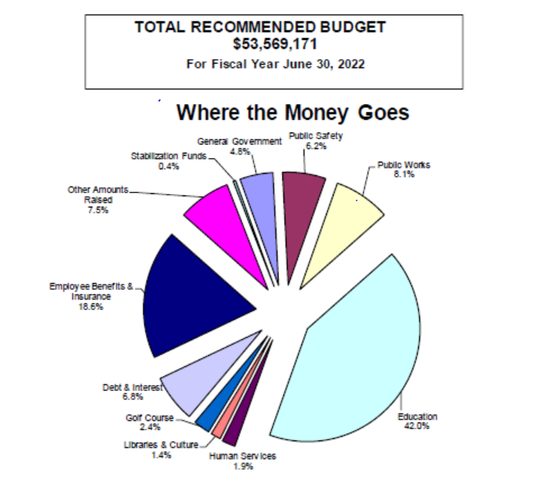
Warrant Article 12 General Fund Operating Budget
Here is how the expenditures breakdown?
General Government operating budget
(excluding the schools, debt, benefits)
increased 1.8% over FY 21.
All in the budget has increased the 3%, the
school budget is up 2.3%.
As state aid and other factors make slight
Adjustments these percentages may change
slightly.

Slide 10
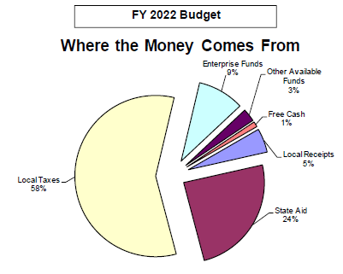
Warrant Article 12 General Fund Operating Budget (continued)
How do we pay for all of this?
As you can see nearly 60% of these come from local taxes
including Real Estate Taxes and Excise Taxes.
The FY 22 budget is and must be balanced by law.
The FY 21 budget will return balances from departments to
Unreserved Free Cash and the revenues for FY 21 will likely
be overestimate by as much as $1.8 million.

Slide 11
Warrant Article 12 General Fund Operating Budget (continued)
Town Meeting Members, residents or interested parties may go to southhadley.org to the Appropriations page https://www.southhadley.org/371/Appropriations-Committeeaccess more information about the budget.
Including the Budget Book which contains multi-year, projections

Slide 12
Warrant Article 12 General Fund Operating Budget (continued)
Some of the changes of note in the FY 22 budget in comparison to the FY 21 budget
The Selectboard budget had the Deputy Town Administrator position cut from its budget, the salary for the future Town Administrator was increased.
The position of Director of Human Resources was added. Together the increase was about $30K to the budget overall
The Reserve Fund was cut by $13,000. With the changes from end of year reconciliation and good budgeting it is less needed to offset budget errors.

Slide 13
Warrant Article 12 General Fund Operating Budget (continued)
There was a $23,582 reduction the Town Clerk salary line as the clerical position has been returned to part time. We continue to review retention issues and try to find the right balance. The Clerk’s salary also increased for FY 22.
The Elections Budget was reduced by $29,300 as there will be (2) less elections in FY 22, however there will be an additional $8,500 available to staff the election, supplemented by internal Town Hall staff and to cover in office election related tasks.
The Police budget is up $93,288 with the addition of a part-time dispatcher, increased contract and additional training. The areas of supplemental training being mandated by the Chief are crucial to continuing to have an evolving public safety complex.
The Health Department is up $35,314 with the addition of a Health Compliance Officer. This position will be partially funded by the CARES Act grant.

Slide 14
Warrant Article 12 General Fund Operating Budget (continued)
The Council on Aging budget increased by $55,805 including adding a new fulltime Activities Coordinator. This is in anticipation of the opening of the new facility with expanded programing and expanded hours.

Slide 15
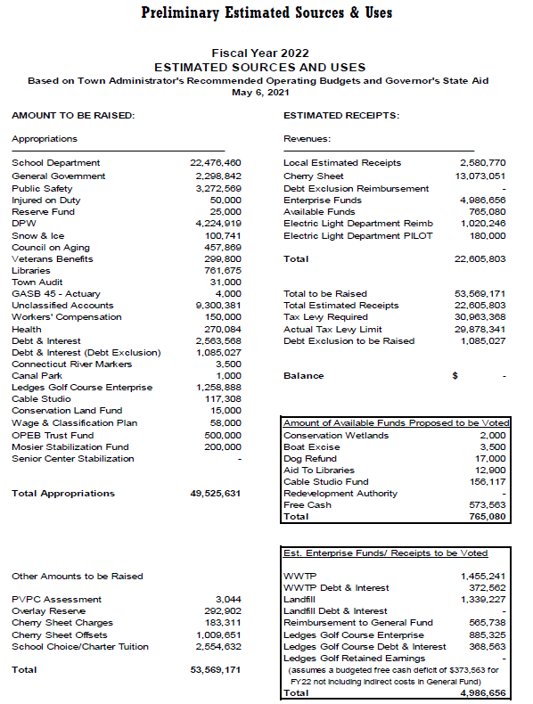
“Sources and Uses” https://www.southhadley.org/371/Appropriations-Committee
This standard form depicts the overall budget balance for the FY 22 Budget.
It also includes the “Enterprise Funds” Solid Waste/Landfill, WWTP and Ledges Golf Course.
$49,525,631 is the amount to raised by taxation and expended to provide services to the community
Add the $4,043,540 for Enterprise Funds (paid by ratepayers) equals a $53,569,171 total budget for FY 22

Slide 16
Warrant Article 13 Easement 15 Kimberly Drive
This article authorizes the Selectboard to act on behalf of the Town of South Hadley to allow a transfer of sewer easement at 15 Kimberly Drive from one owner to another in order to effectuate a sale of the home and property.
These are not very common warrant articles but have come up from time to time to allow transfer of ownership.
The language of the warrant has been reviewed by Town Counsel and by the attorneys for the seller and buyer.

Slide 17
Article 14 Hand-held Devices
This By-law change would be to allow the use of these handheld devices at future Special and Annual Town Meetings to tabulate voting.
They were purchased as allowed by federal funds for pandemic relief and/or safety measures related to COVID 19.
These types of devices are used successfully throughout the Commonwealth and are intended to increase both accuracy and efficiency.

Slide 18
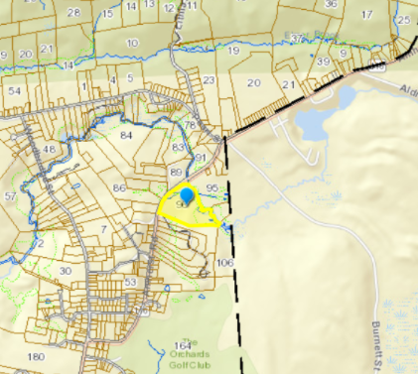
Warrant Article 15 Purchase of Property
This appropriation of $197,700 from Unreserved Free Cash
To purchase a bio-critical parcel on the Mount Holyoke Range from
The owner is presently “O’Meara et al Properties”.
It is 20.7 acres which adjoins Mass DCR land near east of Amherst Road
The Conservation Administration has secured a reimbursable grant for the same amount from Commonwealths Land Grant Program.
The Town of South Hadley must complete the sale by June 30, 2021, to receive reimbursement from the state.
The land will be under the stewardship of the South Hadley Conservation Commission going forward under Article 97 of the Commonwealth’s Constitution. Essentially protecting the land in perpetuity.

Slide 19
Warrant Article 16 Acceptance of River Lodge Road
A hearing will be held on June 1, 2021, before the South Hadley Selectboard on this acceptance of River Lodge Road portion under the ownership of Meredith Properties (Riverboat Village) as requested
The dispute of responsibility for this unaccepted goes back well into the previous century.
Meredith in good faith has brought the road up to an acceptable standard investing in culvert repair, new subsurface and new asphalt.
The representative for Meredith has agreed to consider guardrails but has not committed as of this date (May 25). This acceptance does not necessarily require installation of the devices.
Acceptance will require the Town of South Hadley to fully maintain the road going forward and allow the municipality to include the road on its Chapter 90 grant application.
It also fulfills a commitment the Town of South Hadley made to the developer of the new homes along River Lodge Road.

Slide 20
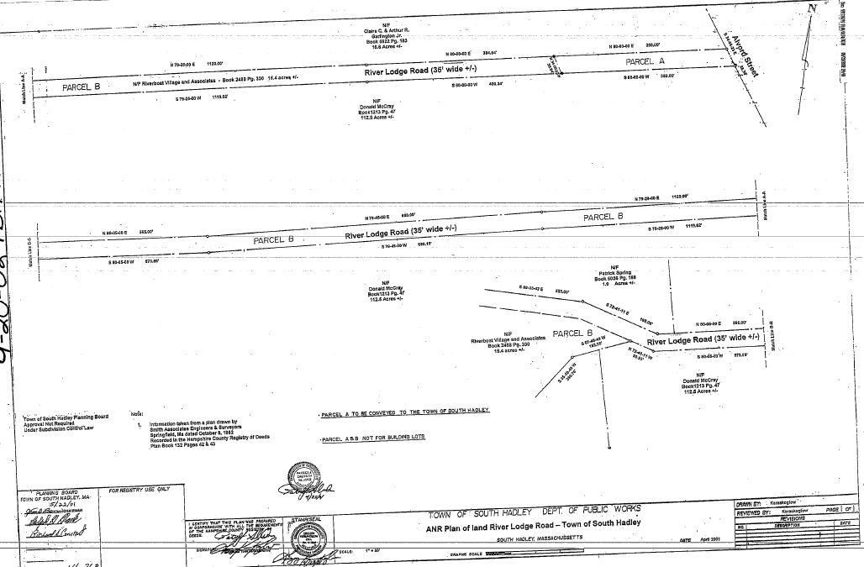

Slide 21
Warrant Article 17 Agricultural Restriction Lauzier Farm
The article asks for appropriation of $150,000 of Unreserved Free Cash (URFC) as part of a $190K match of $1.9 million purchase of an easement to permanently protect this property for agricultural uses only.
Beyond the $150K of URFC the Conservation will pay the balance from their Land Conservation Fund.
The $1.7 million plus will be paid by the Massachusetts Department of Agriculture so the land will be available to continue to be used a working farm.
There is a caveat in the warrant article which encourages fundraising and grant applications in hopes of not using much or perhaps any of the $150K. In order to be used after fundraising opportunities are exhausted there would have to be separate votes by the Selectboard, Appropriations and the ConsCom to release the funds.
The state demanded a vote by Town Meeting to signal the Town was willing to participate fully.
As is the case with any article any unspent funds are returned to the General Fund URFC.

Slide 22
Warrant Article 18 WWTP Capital Improvements
This article is to spend Retained Earnings from the WWTP Enterprise account on the improvements listed in the warrant. $1,051,470 is the present balance of this account
ARTICLE 18. To see if the Town will transfer from WWTP Retained Earnings the sum of $485,000 to make the following purchases, repairs, or replacements; Plant Roof Repair ($85,000 estimate), Generator Replacement ($400,000 estimate) related to the WWTP operations or take any other action relative thereto.

Slide 23
Warrant Article 19 URFC Capital Expenditures
Similarly, these are the Capital Investments recommended by the Town Administrator for FY 22 to be funded from URFC. The balance of URFC $4.3 million when certified by the DOR in October 19.
The High School Dishwasher has been utilized through the pandemic and was well past its useful life prior to the pandemic, the Smart Boards are also showing age and are falling behind in terms of technological capability and as we return to classrooms it is important to invest in the technology.
The cruisers will replace vehicles which are out of warrantee (over 120,000 miles), they will be purchased in a staggered manner and will all be hybrid “Interceptors” (Police package SUVs).
The Dispatch Communication System is beyond warrantees to the point many of the component parts are no longer available. While it is a significant investment it does serve the whole community with an important public safety benefit. It also assists both Fire Districts, the DPW and outside agencies when necessary. The Chief has worked with SHELD to reduce the reliance on copper lines from the phone company to produce a better redundant system which will be less expensive each month.
ARTICLE 19 To see if the Town will transfer from Unreserved Free Cash the sum of $1,748,000 to make the following capital purchases, repairs, or replacements; Dispatch Communications System $1,300,000, $236,000 for purchase of three police cruisers, $82,000 High School Dishwasher, $30,000 High School Smart Board, $100,000 to replace IT system servers related to municipal operations or take any other action relative thereto.

Slide 24
Warrant Article 20
This articles takes some of the URFC and places them in “Stabilization” accounts.
This strategy adds a layer of benefit as a municipal savings account, both from an investment perspective and as noted in prior meetings it take a two thirds vote of Town Meeting to distribute any of these funds after they are voted into a stabilization account.
The General Stabilization Fund has $2.2 million, and the Capital Stabilization has $1.9 million prior to any action at the June 9 Annual Town Meeting
ARTICLE 20 To see if the Town will transfer from FY 21 Unreserved Free Cash the sum of $400,000 which $200,000 will be transferred to the Stabilization Fund and $200,000 transferred to the Capital Stabilization Fund or take any other action relative thereto.

Slide 25
Thank you!
Please send any questions you may have to msullivan@southhadleyma.gov

